Slide 1
Machine Learning in Practice I
Lecture 7
Antal Jakovac, 2025

Slide 2
k-nearest neighbour (KNN) model

Slide 3
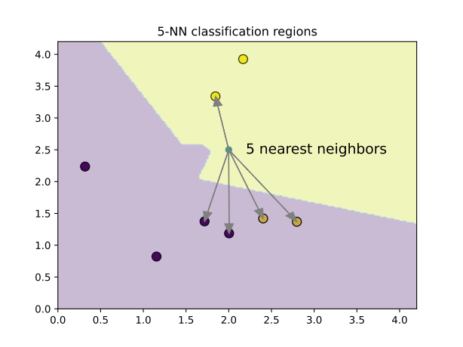


KNN
a different idea: similar points are close in the feature space
for a good guess on the class peek the neighbouring points
algorithm:
  keep all points in the training set
  new point: compute all the distances
  → needs a distance measure
  keep first k closest points
  estimated class: majority vote

Slide 4

KNN
✅ pros
  simple, intuitive, no training phase
  naturally handles multi-class problems
❌ cons:
  slow at prediction time (needs to compare with all samples)
  sensitive to irrelevant features and scaling (c.f. distance measure)
  struggles in high dimensions (“curse of dimensionality”)

Slide 5
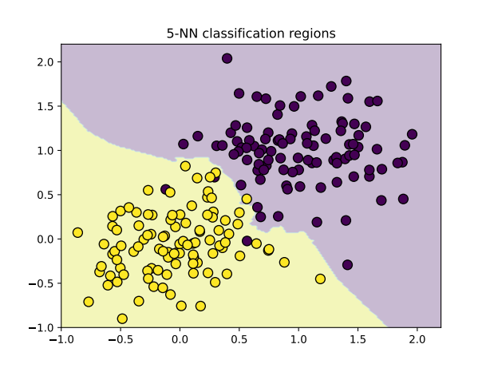
KNN
# Random Forest example
from sklearn import svm
from sklearn.neighbors import KNeighborsClassifier
# Train a 3-NN classifier
knn = KneighborsClassifier(n_neighbors=5)
knn.fit(X,y)
# Predict on the test set
y_pred = knn.predict(X_test)
# Evaluate
acc = accuracy_score(y_test, y_pred)
→ acc = 97.5%
in code

Slide 6
Estimate relevance of features

Slide 7
Relevance of features
not all features contribute equally to the result – to reduce the number of features we shall asses their relevance
idea: measure the change in the result when change the feature
relevance measures (the most used ones)
  feature importance (only for random forest)
  permutation importance, feature masking
  mutual information
  in deep neural networks Gradient-weighted Class Activation Mapping (Grad-CAM)

Slide 8
Relevance of features
we will demonstrate the feature relevance measures in a 2-class 20 dimensional dataset with 2000 elements
# make mulitdimensional dataset
from sklearn.datasets import make_classification
from sklearn.model_selection import train_test_split
ndim = 20
Nsamples = 2000
X, y = make_classification(n_samples=Nsamples, n_features=20, n_classes=2, random_state=42)
X_train, X_test, y_train, y_test = train_test_split(X, y, test_size=0.2, random_state=42)

Slide 9
Feature importance
works only for random forest
idea:
  measure the impurity (e.g. Gini impurity) of all nodes before and after a decision
  if we use a feature for a decision, measure the impurity decrease
  average over the forest

Slide 10
Feature importance
example: create a 20 dimensional dataset with 2000 elements
train a random forest classifier
# make mulitdimensional dataset
from sklearn.ensemble import RandomForestClassifier
# Creating a Random Forest classifier
clf = RandomForestClassifier(n_estimators=100, random_state=42)
# Training the classifier on the training data
clf.fit(X_train, y_train)

Slide 11
Feature importance
example: create a 20 dimensional dataset with 2000 elements
train a random forest classifier
evaluate the result
# evaluate result
from sklearn.metrics import confusion_matrix
# Making predictions on the testing data
y_pred = clf.predict(X_test)
# confusion matrix
cm = confusion_matrix(y_test, y_pred)
accuracy = np.trace(cm) / np.sum(cm)
→ accuracy = 93.5%

Slide 12
Feature importance
example: create a 20 dimensional dataset with 2000 elements
train a random forest classifier
evaluate the result
get feature importance
feature_importance =clf.feature_importances_
→np.array([0.01291599, 0.27999269, 0.01658218, 0.01157727, 0.15054909, 0.01555601, 0.0150478 , 0.01637177, 0.01582075, 0.27170634, 0.01723006, 0.01812296, 0.01401398, 0.01165928, 0.01404261, 0.01398676, 0.01323008, 0.0636087 , 0.01551626, 0.01246943])

Slide 13
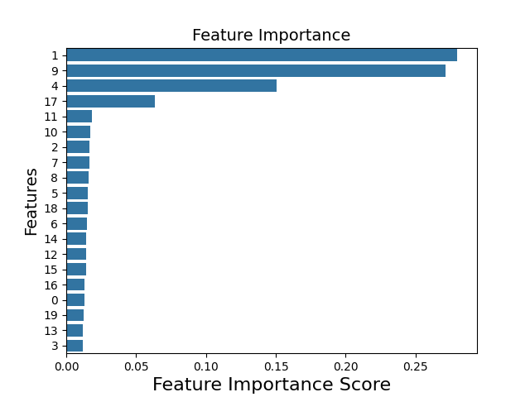
Feature importance
example: create a 20 dimensional dataset with 2000 elements
train a random forest classifier
evaluate the result
get feature importance
visualize it
sorted_idx = np.argsort(feature_importance)[::-1]
plt.figure()
sns.barplot(
x=feature_importance[sorted_idx],
y=np.arange(len(sorted_idx)),
orient='h')
plt.yticks(np.arange(len(sorted_idx)),sorted_idx)

Slide 14
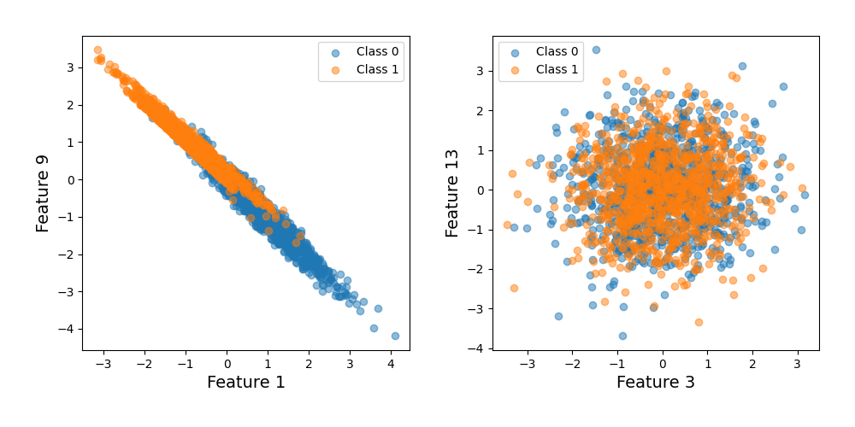
Feature importance
example: create a 20 dimensional dataset with 2000 elements
most (1,9) and least (13,3) important features

Slide 15
Permutation importance
works for all methods
idea:
  train the model, measure the performance – baseline
  for each feature permute the values among samples
  measure the performance again
  relevance of the feature: drop in performance
  instead permutation we can use a constant value (e.g. average), or a random value → mask that feature

Slide 16
Permutation importance
get permutation importance in Pyhton
# import package
from sklearn.inspection import permutation_importance
# use trained model clf to calculate importance
result = permutation_importance(clf, X_test, y_test, n_repeats=10, random_state=42)
# read mean and variance of the estimates
importances = result.importances_mean
std = result.importances_std

Slide 17
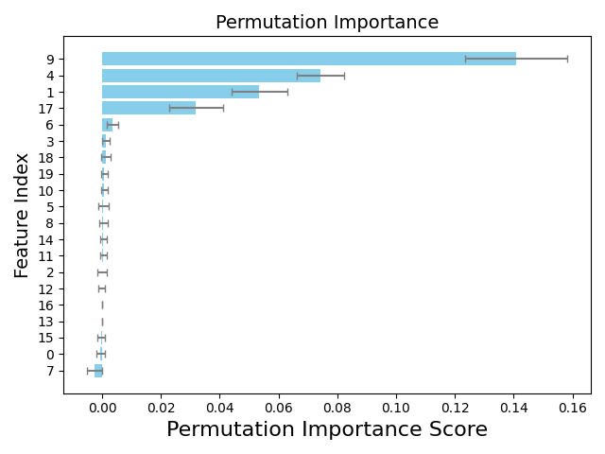
Permutation importance
get permutation importance in Pyhton
visualize the result
same features are selected as
before, but order is different

Slide 18
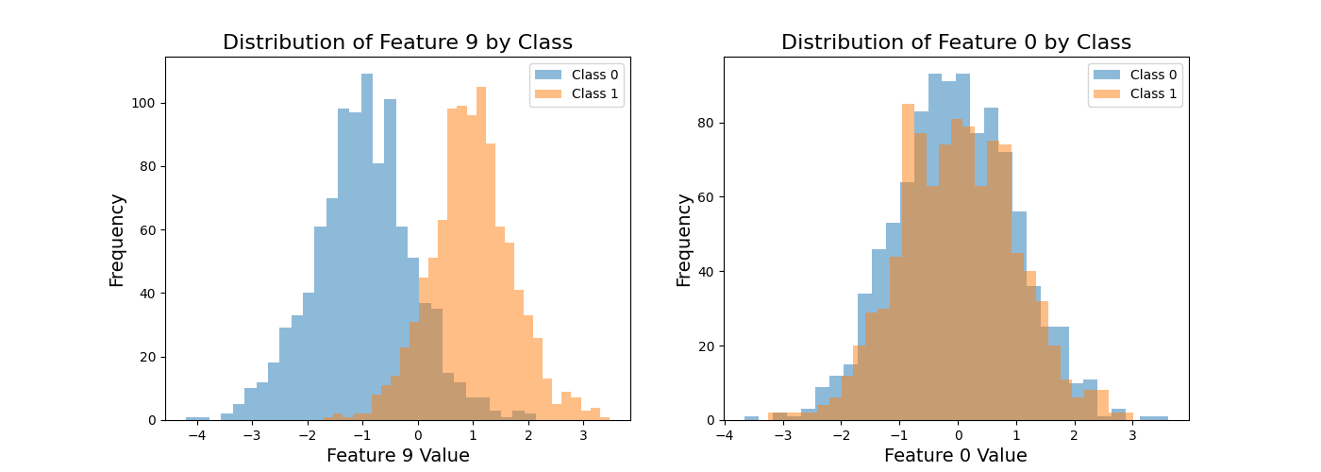
Permutation importance
choose feature 9, and feature 0 to demonstrate the effect
plot the distribution of the given feature, conditioned for the class (histogram)

Slide 19
Mutual information
can be used for any models – for any two set, actually
idea:
  calculate the joint probability of two sets
  if x and y are independent, then the joint probability is the product
  measure the dependence (mutual information) by
  can be used to measure mutual information between features and labels
independent

Slide 20
Mutual information
in Python there is a package to calculate mutual information
the code
# import package
from sklearn.feature_selection import mutual_info_classif, mutual_info_regression
# we can use the original labels, or the model-predicted ones
# characteristic for both the system and the trained model
# y = clf.predict(X)
mi_model = mutual_info_classif(X, y, random_state=42)
mi_model /= np.sum(mi_model)

Slide 21
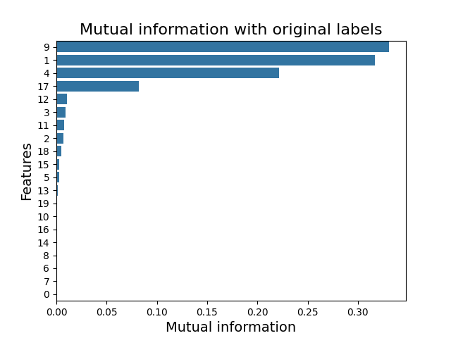
Mutual information
in Python there is a package to calculate mutual information
the code
visualization
similar result as before

Slide 22
END OF LECTURE 7

